Slide 1
Steps to Perform PCA
Centralize the Data: 2. Compute the Covariance Matrix: The covariance matrix summarizes the relationship between each pair of features. For standardized data, the covariance matrix shows how features vary together.
3. Calculate Eigenvalues and Eigenvectors: Eigenvectors (principal components) of the covariance matrix determine the directions of maximum variance. Eigenvalues indicate the amount of variance along these directions.
4. Sort Eigenvectors: Sort the eigenvectors in descending order according to their eigenvalues. The top eigenvectors correspond to the directions with the most significant variance.
5. Project the Data: To reduce the dimensionality, select the top k eigenvectors and project the original data onto this k-dimensional subspace

Slide 2
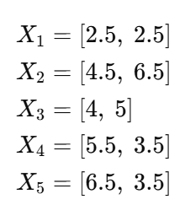
Perform PCA to reduce the 2-dimensional data to 1 dimension

Slide 3
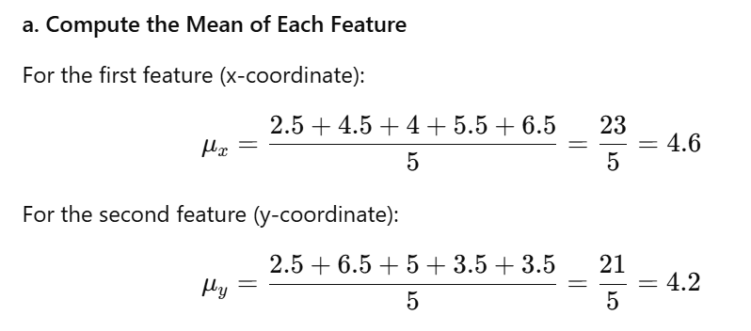
Perform PCA to reduce the 2-dimensional data to 1 dimension

Slide 4
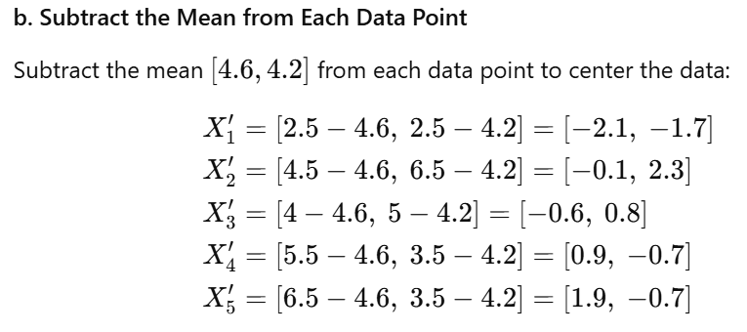
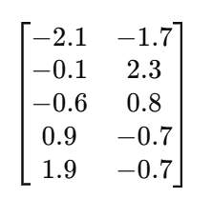
Perform PCA to reduce the 2-dimensional data to 1 dimension
We get the X centered matrix as ,

Slide 5
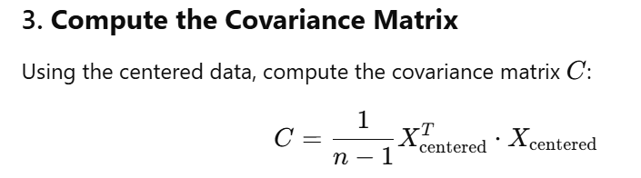
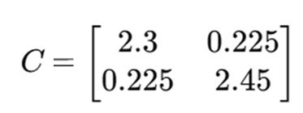

Slide 6
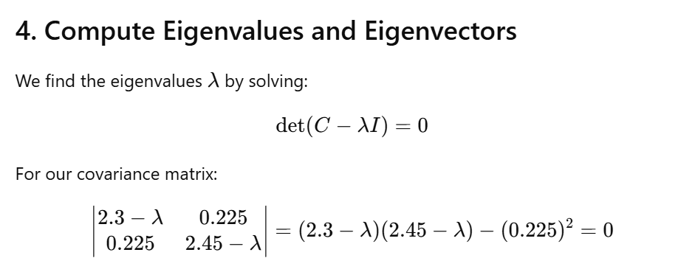
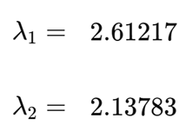
Solving which we get the eigenvalues:

Slide 7
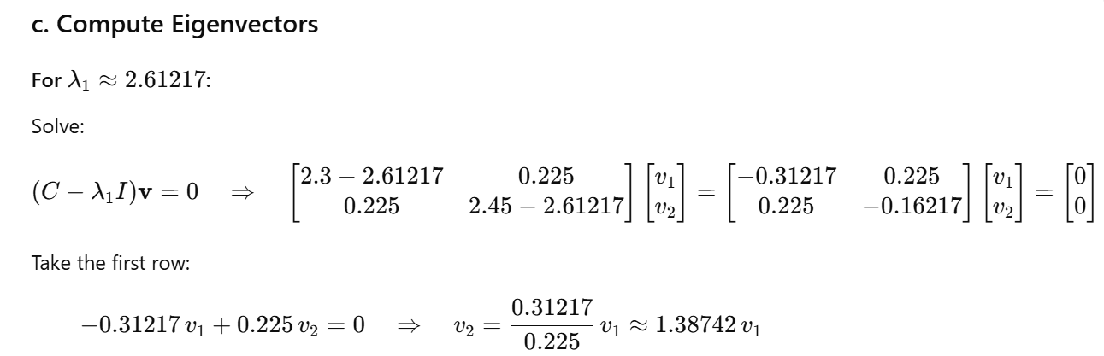
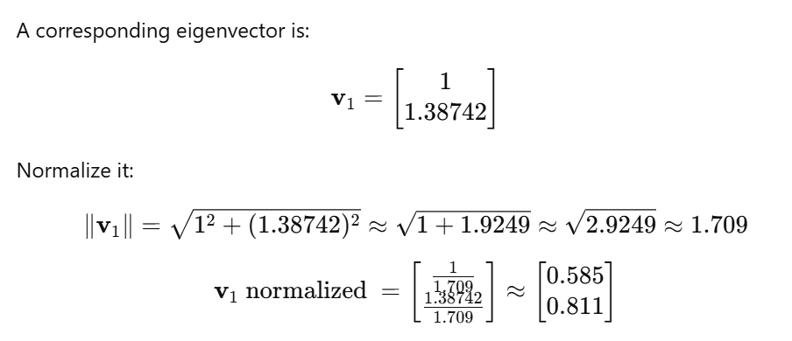
V1 normalized your PC1

Slide 8
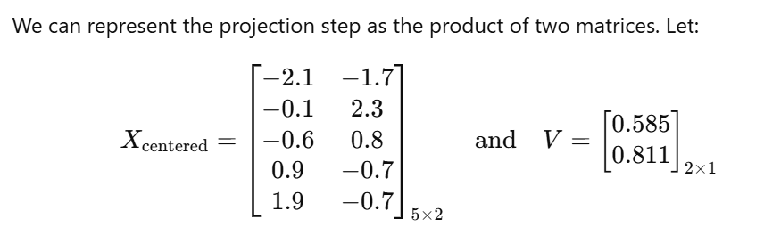
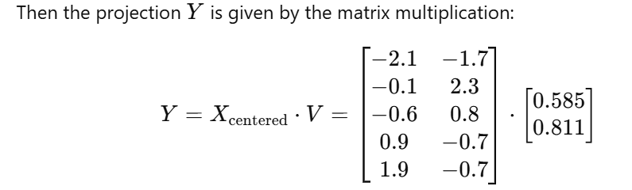
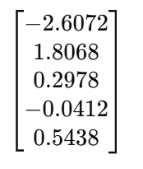

Slide 9
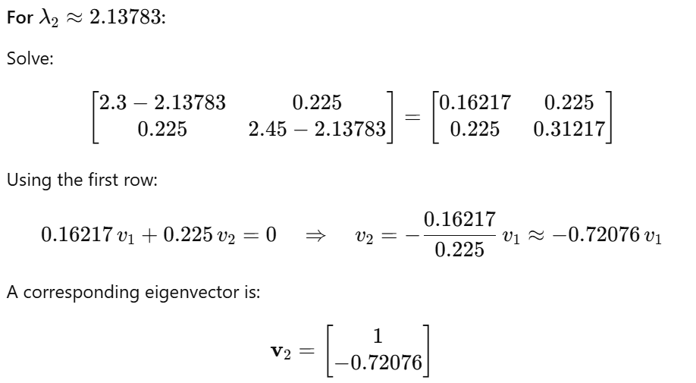

If you want to transform the data to 2D again then we need to find the other eigenvector as well and proceed as below.
V2 normalized is PC2

Slide 10
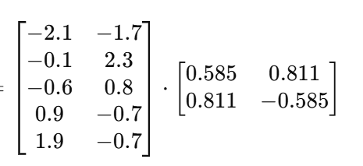
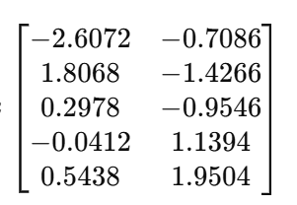
If we want to project the data to the same space to 2-dimensional again then, multiply X centered with the matrix of eigenvectors
Here we are trying to represent the data in two new axis which are the PC1 and PC2

